Slide 1

Department of Computer Science and Engineering
DeepWaterSeg: High-Resolution Satellite Imagery Analysis for Water Body Extraction Using ResNet-U-Net
PRESENTED BY
R. Anjaneya Kumar (22471A0545)
K. Durga prasad (22471A0531)
S. Matheena baba (22471A0559)
S. Shaahid (22471A0554)
Under the Guidance of,
Sk. Kaja Mohiddin Basha _{M.Tech}
Associate Professor ,
Department of Computer Science and Engineering,
Narasaraopeta Engineering College (Autonomous),
Narasaraopet- 522 601.

Slide 2
OUTLINE
Abstract
Introduction
Literature Survey
Research Gaps
Problem Statement
Objectives
Block Diagram / Flow Diagram
Methodology
Implementation
Results and Analysis
Conclusion & Future Scope
References
Acknowledgements
Question and Answers

Slide 3
ABSTRACT
This work focuses on accurate water body extraction from high-resolution satellite images using a ResNet50-based U-Net architecture. The model effectively identifies rivers, lakes, and ponds across varied terrains. With efficient preprocessing and training, the approach achieved strong results, including 96% precision and 92% accuracy, demonstrating reliable segmentation performance. These results support improved disaster response, freshwater monitoring, and environmental management applications.

Slide 4
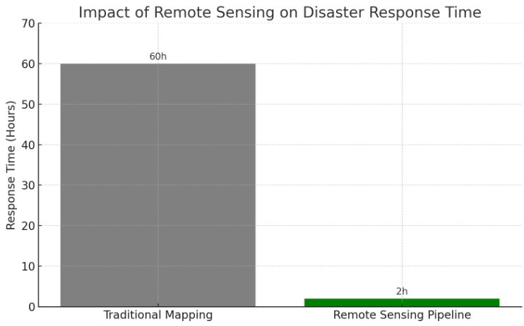
INTRODUCTION
Water bodies such as rivers, lakes, and ponds are essential for sustaining ecological balance, agriculture, industry, and human life. Effective monitoring and extraction of these water bodies are crucial, especially during disasters like floods where timely response is needed. Traditional methods of water body identification are slow and prone to inaccuracies. With advancements in remote sensing and deep learning, automated segmentation has become more efficient. This research utilizes high-resolution satellite imagery and a ResNet50-based U-Net architecture to achieve precise water body segmentation, ensuring improved detection of thin and irregular water boundaries across diverse landscapes for resource management and disaster planning.

Slide 5
LITERATURE SURVEY
Sno | Title | Author | Publisher and Year | Methodology used | Key findings | Gaps
1. | DMLU-Net: A Hybrid Neural Network for Water Body Extraction | Z. Xu, M. Li, H. Guo | MDPI – Applied Sciences, 2025 | Dual-encoder based U-Net architecture | Improved segmentation of thin and narrow water boundaries | Requires large dataset and high GPU resources
2. | Mapping and Monitoring Small Surface Water Bodies | M.C. Chagas, A.P. Falcão, R.P. de Oliveira | MDPI – Remote Sensing, 2025 | Sentinel-based temporal and spectral index analysis | Effective for small water body tracking over time | Needs manual preprocessing and lacks automation
3. | High-Precision Water Area Reconstruction Using Stereo Satellite Images | J. Ye, R. Xu, Y. Wang, X. Huang | MDPI – Remote Sensing, 2025 | Stereo-pair + semantic segmentation | High accuracy in urban and vegetation-dense scenes | Complex model → hard for real-time deployment
4. | Hybrid Deep Learning for Accurate Water Body Segmentation | M. Attya et al. | Springer – Earth Science Informatics, 2025 | CNN with attention mechanisms | Accurate segmentation even with reflection and shadow noise | Computationally heavy; requires advanced hardware

Slide 6
LITERATURE SURVEY
sno | Title | Author | Publication and year | methodology | Key findings | Gaps identified
5 | SDNet: Sandwich Decoder Network for Waterbody Segmentation | H. Ni, J. Li, C. Wang | IEEE – JSTARS, 2025 | Multi-path decoder network | Achieves high edge preservation and segmentation clarity | Training is slow and resource-intensive
6 | Segmentation of Flooded Regions using U-Net and SAR Imagery | F. Pech-May et al. | IEEE – JSTARS, 2024 | U-Net on Sentinel-1 SAR images | Works well for flood detection in cloudy conditions | SAR data preprocessing is complex
7 | Extraction of Water Bodies from High-Resolution Aerial and Satellite Images Using Visual Foundation Models | S. Ozdemir, Z. Akbulut, F. Karsli, T. Kavzoglu | MDPI – Sustainability, 2024 | Used CLIP-based Visual Foundation Model and SAM (Segment Anything Model) | Achieved 94.41% segmentation accuracy across mixed land surfaces | Requires high-quality images; performance decreases on low-resolution satellite data

Slide 7
RESEARCH GAPS
Large and Diverse Data
Many existing water body segmentation methods depend on large, diverse, and high-quality datasets. However, such datasets are not always easily available, which limits scalability, reduces generalization, and affects real-world applicability.
Complex models
Several advanced deep learning models used for water body segmentation are highly complex and computationally expensive, making them difficult to train, requiring powerful hardware, and limiting real-time deployment in practical field environments.

Slide 8
PROBLEM STATEMENT
Accurate identification of water bodies from satellite imagery remains challenging due to variations in landscape, water color, shadows, and seasonal changes. Traditional methods are slow and less reliable, while existing deep learning models often require large datasets and high computational resources. Therefore, there is a need for an efficient and accurate approach for water body extraction that performs well across diverse terrains.

Slide 9
OBJECTIVES
To utilize minimal and efficiently selected training data while still enabling the model to learn meaningful water body patterns.
To develop a simpler and non-complex model architecture that reduces computational cost and supports easier real-time deployment.
To achieve high segmentation accuracy and reliable results in detecting diverse water bodies across varying landscapes using the optimized model.

Slide 10
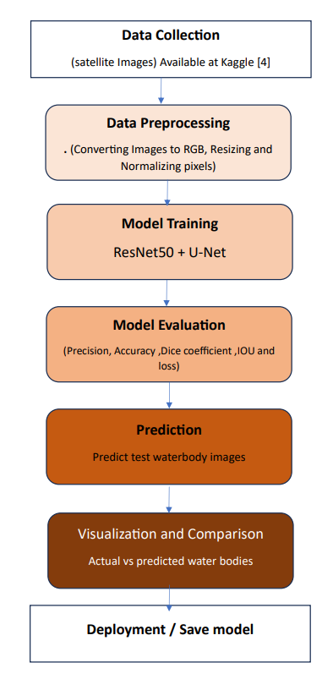
METHODOLOGY
This current research work involves in typical Machine learning workflow simply as mentioned in the image side way that includes Data Collection, Data Preprocessing , model Training ,Evolution and prediction
Each steps are furtherly elaborated in detailed in the upcoming slides

Slide 11
METHODOLOGY - Data Collection and Preprocessing
Data Collection:
As satilite images are sensitive information most of the websites/organizations doesn’t offer satilite imagery data so I have decided to settle down with a data repository from Kaggle available at link
Data Preprocessing:
Convert Images from BGR to RGB
Convert Mask Images to Grayscale
Resize Images and Masks to 256 × 256
Normalize Pixel Values (0 to 1 Range)
Expand Mask Dimensions to Add Channel (H × W × 1)
Split Dataset into Training and Validation Sets

Slide 12
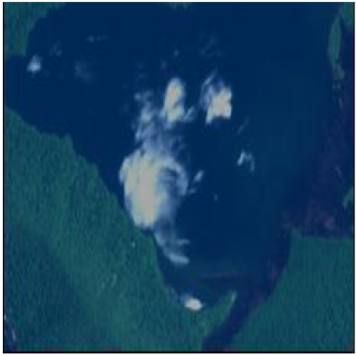
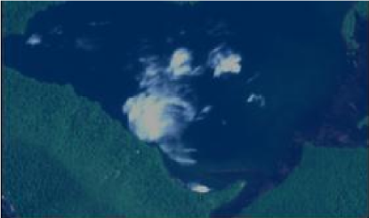
METHODOLOGY Before and After preprocessing

Slide 13
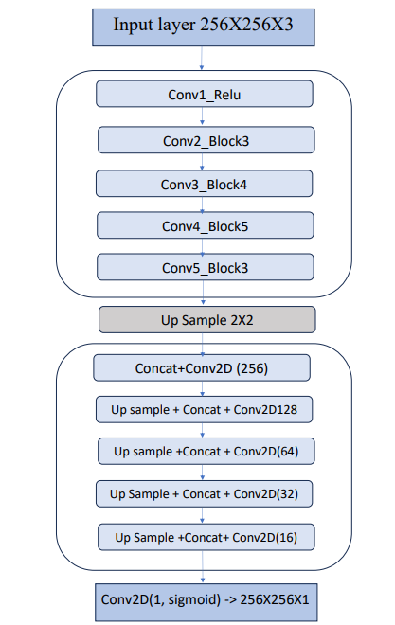
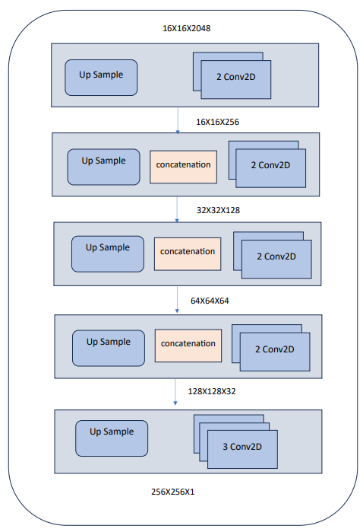
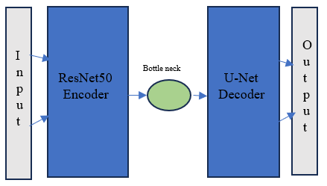
Model Training – Architecture /Block Diagram
Detailed Block Diagram(ResNet50 + UNet) with layer specification
Detailed Block diagram of UNet encoder with layers
Higher level Block Diagram

Slide 14
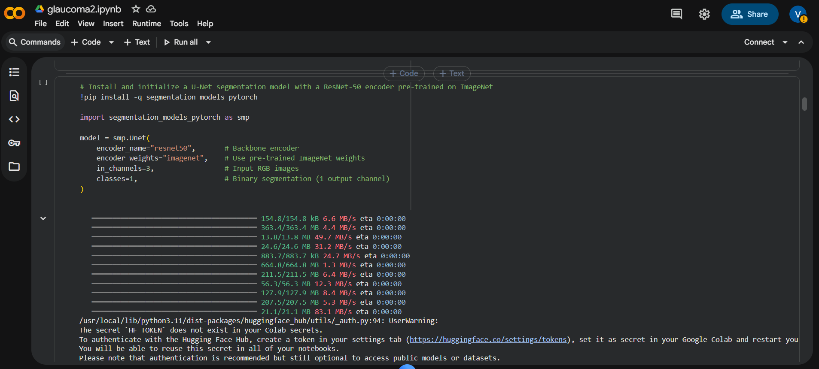
Implementation and Model Hyper parameters
Parameter | Value
Input Shape | 256 × 256 × 3
Learning rate | 0.0001
Optimizer | Adam
Loss Function | Binary Cross Entropy
Epochs | 30
Batch Size | 8
Activation Functions | Relu + sigmoid
Validation Split | 20%
Filters (Decoder) | 256 → 128 → 64 → 32 → 16 → 1
Smoothing Factor (ε) | 0.000001

Slide 15
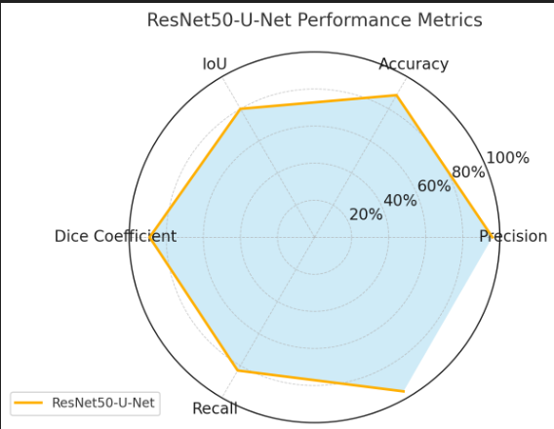
Model Evolution
Metric | Result
Precision | 96%
Accuracy | 92%
Dice Coefficient | 91%
Intersection over Union (IoU) | 90%
Loss | 6%

Slide 16
System Requirements
Hardware Requirements
Processor : intel Core i5
Cache memory : 4MB(Megabyte)
RAM : 12.7GB (gigabyte)
Hard Disk : 166.8GB
Compute Engine : T4 GPU
Software Requirements
Operating System : Windows 10, 64-bit Operating System
Coding Language : Python
Python distribution : Google Colab , Flask
Browser : Any Latest Browser like Chrome

Slide 17
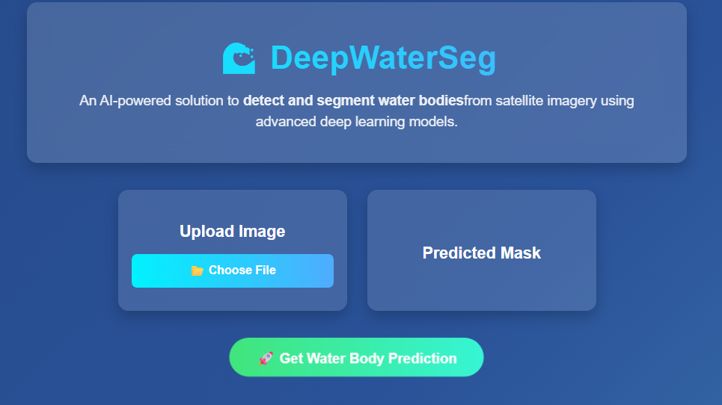
Implementation of Frontend (First UI)

Slide 18
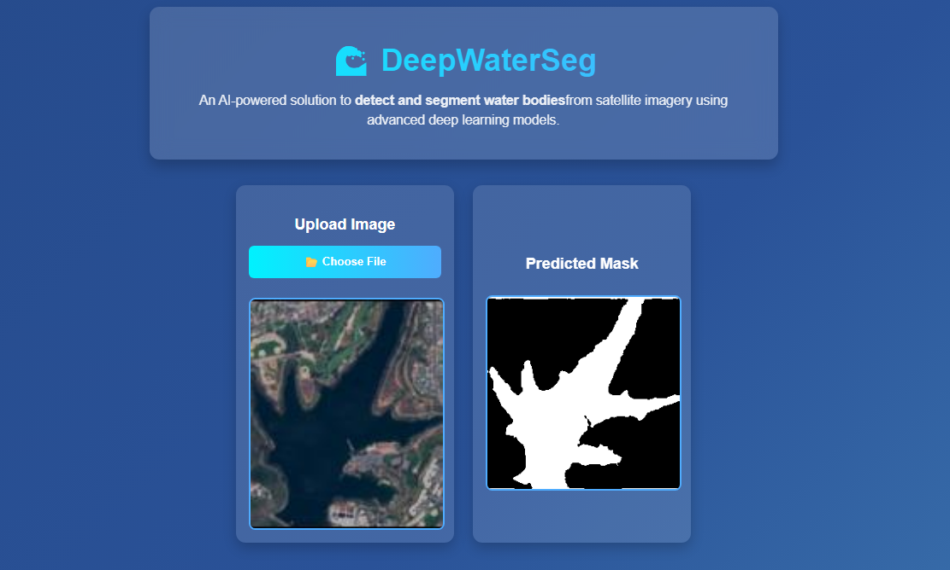
Implementation of Frontend – Testing with Input

Slide 20
CONCLUSION FUTURE SCOPE
This work presents an efficient approach for accurate water body extraction using a simplified ResNet50-U-Net model. By utilizing minimal data and reduced complexity, the model achieves high segmentation performance. The results support effective freshwater monitoring, disaster response, and resource management, demonstrating strong potential for real-world deployment.
In the future, this model can be extended to large-scale real-time monitoring systems for flood detection and drought assessment. Integration with GIS platforms and IoT-based sensors can enhance automated water resource management. Further improvements may include incorporating multi-temporal satellite imagery, attention-based feature refinement, and lightweight deployment on edge devices to support remote and low-power field environments.

Slide 21
CONCLUSION | FUTURE SCOPE
This work presents an efficient approach for accurate water body extraction using a simplified ResNet50-U-Net model. By utilizing minimal data and reduced complexity, the model achieves high segmentation performance. The results support effective freshwater monitoring, disaster response, and resource management, demonstrating strong potential for real-world deployment. | In the future, this model can be extended to large-scale real-time monitoring systems for flood detection and drought assessment. Integration with GIS platforms and IoT-based sensors can enhance automated water resource management. Further improvements may include incorporating multi-temporal satellite imagery, attention-based feature refinement, and lightweight deployment on edge devices to support remote and low-power field environments.

Slide 22
REFERENCES
Xu, Y., et al., “DMLU-Net: Dual Encoder U-Net for Water Body Segmentation,” Applied Sciences, 2021.
Chagas, G., et al., “Mapping Small Water Bodies Using Sentinel-2 Imagery,” Remote Sensing, 2020.
Ye, Z., et al., “High-Precision Water Surface Reconstruction from Stereo Satellite Images,” Remote Sensing,
2022.
Attya, A., et al., “Attention-Based CNN for Water Body Extraction,” Earth Science Informatics, 2021.
Jonnala, R., et al., “AER U-Net for Multi-scale Water Segmentation,” Scientific Reports, 2023.
Ni, S., et al., “SDNet: Sandwich Decoder for Thin Water Body Segmentation,” IEEE JSTARS, 2022.
Ronneberger, O., et al., “U-Net: Convolutional Networks for Biomedical Image Segmentation,” MICCAI, 2015.
He, K., et al., “Deep Residual Learning for Image Recognition,” IEEE CVPR, 2016.
McFeeters, S., “NDWI: A Water Index for Remote Sensing,” International Journal of Remote Sensing, 1996.
Feng, Y., et al., “Surface Water Mapping Using Machine Learning and Landsat Imagery,” Journal of Hydrology,
2021.
Hu, T., et al., “Water Extraction Using Sentinel-1 SAR with Deep Networks,” ISPRS Journal of Photogrammetry,
2020.
Zhang, Q., et al., “Global Surface Water Detection Using Deep Semantic Segmentation,”
Remote Sensing of Environment, 2019.

Slide 23
ACKNOWLEDGEMENTS
I would like to express my sincere gratitude to my project guide, sk. Kaja mohiddin basha, for providing continuous support, valuable guidance, and encouragement throughout the development of this project. I am also thankful to the Department of Computer Science and Engineering, [College Name], for offering the necessary resources and a productive environment to carry out this work.
My heartfelt thanks to my faculty members and lab staff for their technical assistance and constructive suggestions. I also extend my appreciation to my friends and classmates for their cooperation and motivation during various stages of this project.
Lastly, I am deeply grateful to my family for their constant encouragement, moral support, and belief in my capabilities. Without their support, the completion of this project would not have been possible.
Thank You

Slide 24
Q&A

